Slide 1

DS & ML Project
Statement: Train ticket Price Prediction within Spanish Rail setup
Algorithm used: Polynomial Regression based on MLR.

Slide 2

Problem Statement
We are given a data set about trains and travelers from the Spanish rail system and we want to remove null values, manipulate the data, and make plots so that we can predict/ determine the Price/ cost of the trains.

Slide 3
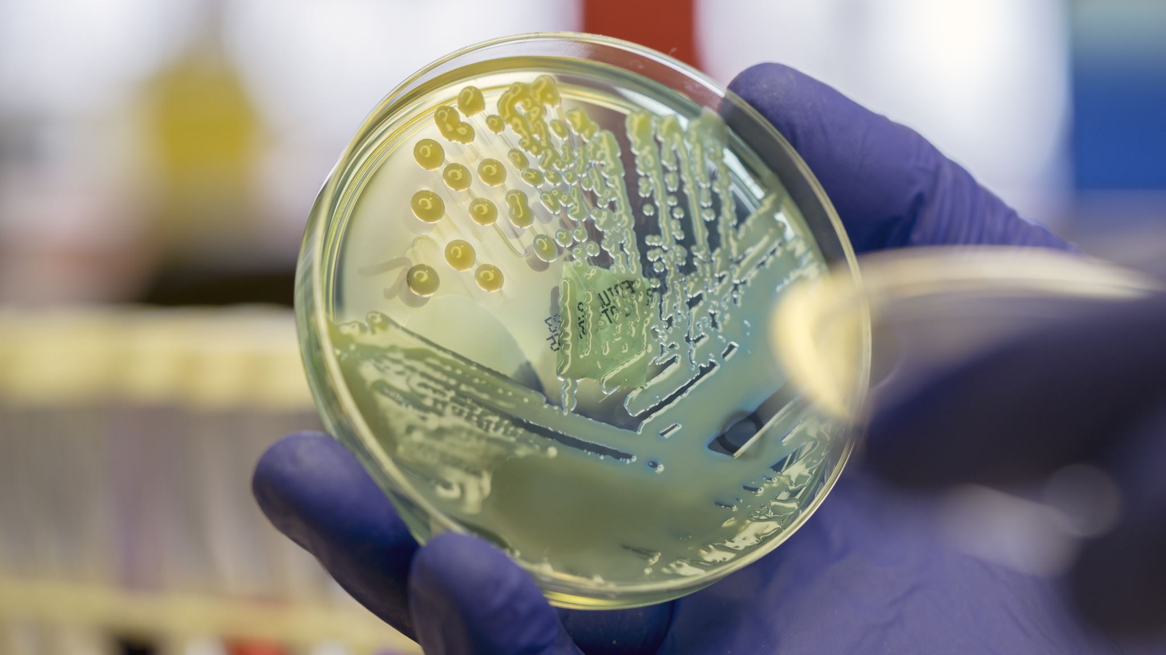
Analysis on Acquiring and Injestion/ETL
Acquisition is when you gather raw data from various sources (from databases). It’s important to make sure the data is useful, accurate, and in the right format for analysis.
Ingestion is moving the data into a central system like a data warehouse or cloud storage. This can be done in batches (all at once) or streams (in real-time).
ETL stands for Extract, Transform, Load which is the process of gathering data from multiple sources, transforming it into a usable format, and loading it into a destination system like a database or data warehouse.
ETL helps make data easier to analyze by cleaning and organizing it, so you can get better insights.

Slide 4
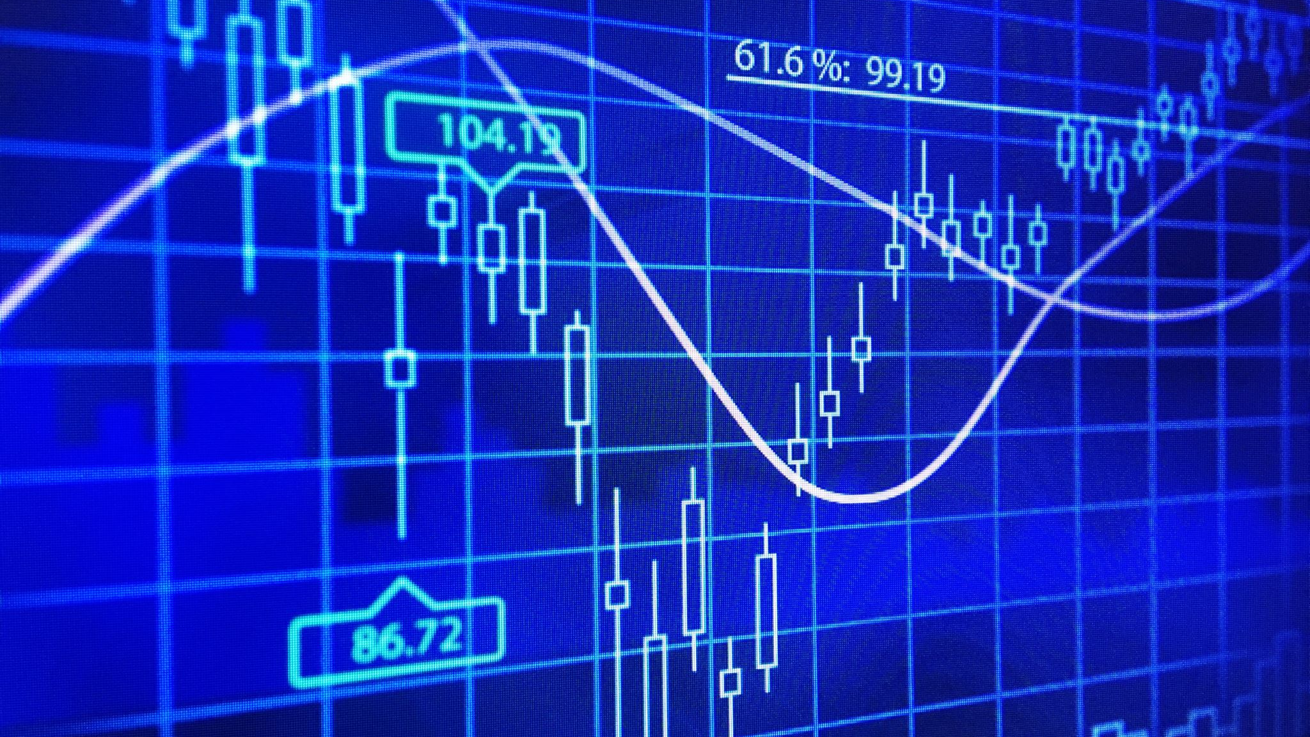
Exploratory Data Analysis
DATA WRANGLING
EDA is exploring the dataset to understand patterns, trends, and key characteristics through visualizations and statistics. This helps identify what’s important or needs cleaning.
Data wrangling is cleaning and transforming raw data into a usable format. It’s fixing issues found during EDA, like removing duplicates, filling missing values, and formatting data properly.
EDA and data wrangling are very important as they help you make sense of messy data and prepare it for deeper analysis. Without these steps, you could miss important insights or make wrong conclusions.
Python libraries like Pandas, Matplotlib, and Seaborn make EDA and data wrangling faster and easier.

Slide 5

Exploratory Data Analysis
VISUALIZATION
A key part of Exploratory Data Analysis (EDA), where you use charts and graphs to understand patterns, trends, and relationships in data. Visualisation is important as it makes it easier to spot trends, outliers, and correlations that might be hard to see in raw numbers. It helps turn complex data into clear, actionable insights.
Common Types of Visualizations:
Histograms: Show the distribution of a single variable (e.g., age distribution).
Box Plots: Highlight the spread and outliers in data.
Scatter Plots: Show relationships between two variables (e.g., height vs weight).
Bar Charts: Compare categories or groups (e.g., sales by region).
Heatmaps: Show correlations or patterns in large datasets.
Visualization helps you quickly identify trends, outliers, and patterns, guiding decisions on what to explore or clean further in the data
Libraries like Matplotlib and Seaborn in Python are popular for creating clear, informative visualizations.

Slide 6

Question 01: Explain the summary statistics for the data set
The data set shows where people are travelling to and from as well as the price of the ticket that they bought. It also tells us the type of fare and the class of the train that the person went on. Most of this data was collected during April to June of 2019.

Slide 7

Question 02: What insights do you get from the above plot?
From the pot, we can see that most people travel FROM Madrid.

Slide 8
Question 03: What insights do you get from the graphs?
Most people are travelling TO Madrid (and some from Valencia and Barcelona)

Slide 9
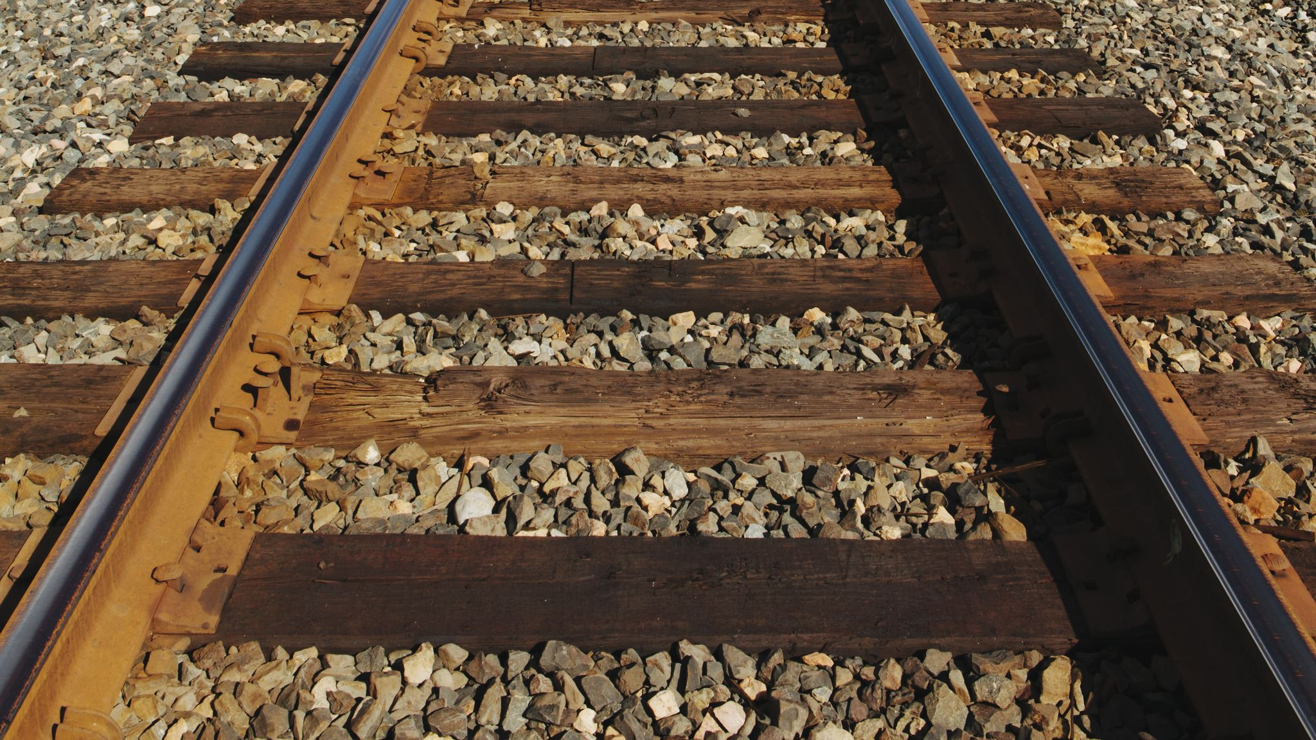
Question 04: Which train runs the maximum in number as compared to other train types?
The “AVE” train runs the most compared to other train types

Slide 10
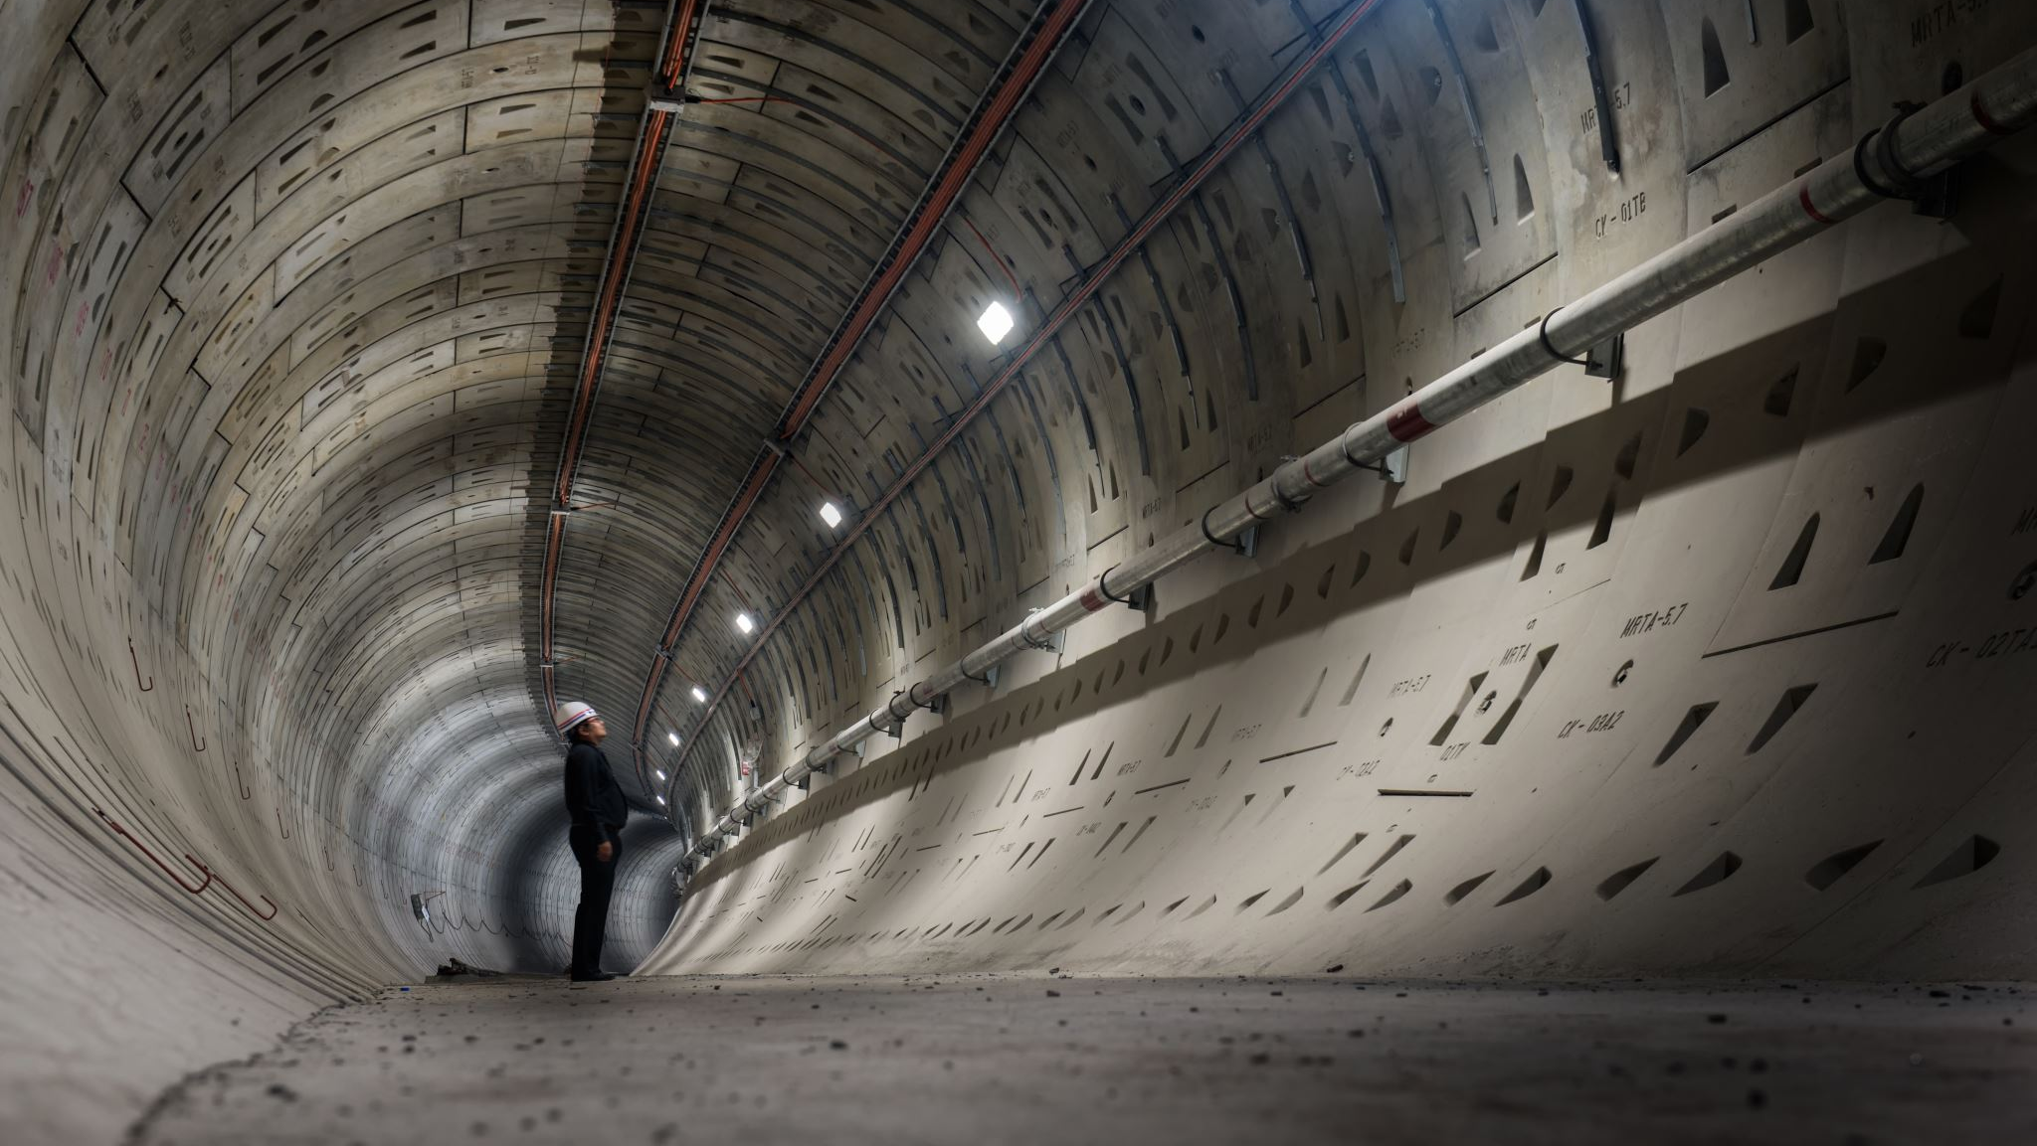
Question 05: Which the most common train class for traveling among people in general?
The “Turista” train is the most common train class for travellers.

Slide 11
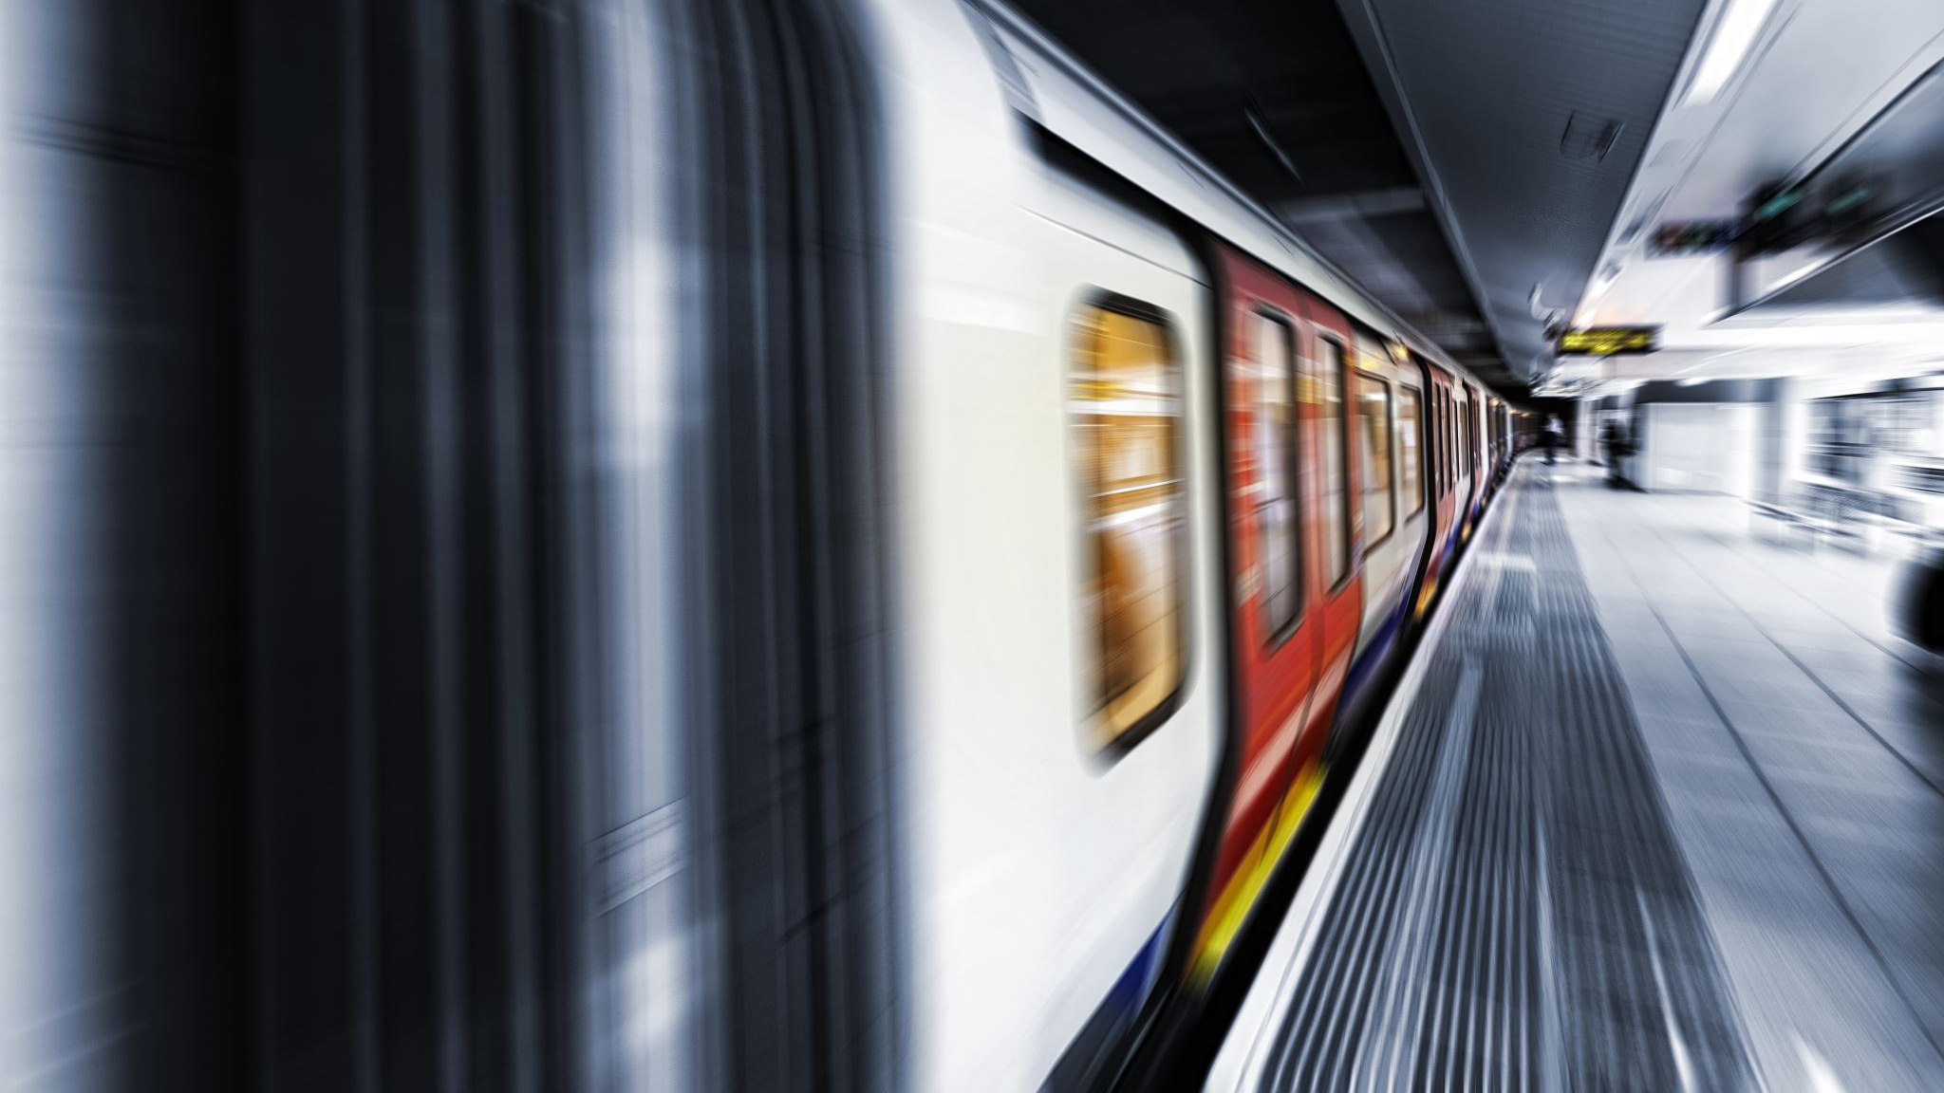
Question 06: Which type of trains cost more as compared to others?
Turista Plus has a slightly higher train price costs compared to the rest of the trains. One outlier in the graph shows that one ticket price costs around 205.

Slide 12

Which model gives the best result for price prediction? Find out the complexity using R2 score and give your answer.

Slide 13

CONCLUSION:

